Slide 1
Electrical Safety
UNIT-III
V Sem (A & B Sections)

Slide 2
UNIT-III: Safety Procedures and Methods
The six Steps safety methods – pre job briefings – hot work decision tree – safe switching of power system – lock out – tag out – flash hazard calculation and approach distances – calculating the required level of arc protection – safety equipment, procedure for low voltage and high voltage systems - the one minute safety audit.

Slide 3
Review-unit-I &II
Electrical safety of personnel (customers/worker/animals)
Electrical Equipment safety
Power system equipment like power transformers, generators, transmission lines, distribution transformers, distribution feeders
House hold appliances
Effective grounding system

Slide 4
Problems & Overcome
Faults – single phase to ground, three-phase faults
Overload, over current, overvoltage, under frequency of machines
Coordinated Protective devices-fuses, circuit breakers, relays
Effective grounding
Power system Restoration
Power system maintenance

Slide 5
De-energized conductor
A conductor that is disconnected from all energy sources by opening all circuit breakers or switches feeding the line
A conductor that is disconnected from any energy source and free from induced voltage due to electromagnetic coupling
A conductor that is disconnected from both of its ends and intentionally grounded at the line sides of the circuit breakers
A conductor that is disconnected from both of its ends and grounded at the worksite

Slide 6
The severity of the induced voltage depends
Voltage and current of the energized line
Proximity of the two lines
Length by which the two lines run adjacent to each other
Fault-current on adjacent lines
Besides induced voltage, the de-energized lines could become energized due to other events such as
Lightning strikes
Switching equipment malfunction
Human error

Slide 7
The six Steps safety methods
Think—be aware.
Understand your procedures.
Follow your procedures.
Use appropriate safety equipment.
Ask if you are unsure, and do not assume.
Do not answer if you do not know.

Slide 8
Think—Be Aware
Many accidents could have been prevented if the injured victim had concentrated on the safety aspects of the job.
Thinking about personal or job-related problems while working on or near energized conductors is a one-way ticket to an accident.
Always stay alert to the electrical hazards around the work area.

Slide 9
Understand Your Procedures
Every company has defined safety procedures that are to be followed.
Workers should be thoroughly familiar with all the safety procedures that affect their jobs. Knowledge of the required steps and the reasons for those steps can save a life.
All employees should go through extensive safety training.

Slide 10
Follow Your Procedures
In the past, some facilities have allowed the violation of safety procedures in the name of production.
Such actions are in violation of the law and have invariably proven to be costly in terms of human injury and/or death.
Violation of safety procedures without good cause should be a discharge offense.
What constitutes “good cause” must be decided on a local basis; however, excuses of lesser significance than immediate danger to life should not be acceptable.

Slide 11
Use Appropriate Safety Equipment
No matter how meticulous workers are, accidents do occasionally happen. Equipment failures, lightning strikes, switching surges, and other such events can cause shock, arc, or blast.
Also, sometimes it becomes necessary for employees to work on or very close to energized conductors, which increases the chance of accidental contact.
Because of these reasons, appropriate safety equipment should be used any time workers are exposed to the possibility of electrical hazards.

Slide 12
Ask If You Are Unsure, and Do Not Assume
Ignorance kills and injures many people each year. No one should ever get fired for asking a question—especially if it is a safety-related question.
Anyone who is uncertain about a particular situation should be encouraged to ask questions, which should then be answered by a qualified person immediately and to the fullest extent possible.

Slide 13
JOB BRIEFINGS
A job briefing (sometimes called a “tailgate meeting”) is a meeting that informs all workers of the job requirements.
In particular, a job briefing is used to alert workers to potential safety hazards.
A job briefing need not be a formal gathering; however, it is mandatory that all workers involved attend, and worker attendance should be documented.

Slide 14
Illustrative Example
Assume that a 20 km de-energized line is accidentally energized by a 2 kV source while a lineman is working at the far end of the line. The line resistance is 0.1 Ω/km, and the worker’s body resistance plus his ground resistance is 1000 Ω.
1. Compute the current passing through the lineman and the voltage across his body.
2. Assume a 0.001 Ω temporary grounding conductor is installed between the line and the ground in parallel with the worker. Compute the current passing through the lineman and the voltage across his body.

Slide 15
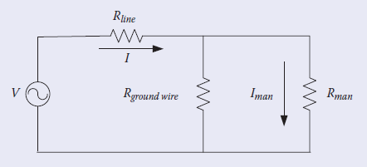





Slide 16
Discuss Issues When?
Special precautions to be taken
Hazards associated with the job
Energy control procedures
Procedures and policies
Personal protective equipment
At the beginning of each shift
At the beginning of any new job
Any time that job conditions change
When new personnel are introduced to an ongoing job

Slide 17
ENERGIZED OR DE-ENERGIZED?
All regulatory standards are quite clear in their requirements, that All circuits and components to which employees may be exposed should be de-energized before work begins.
A few basic points will clarify this requirement:
Production or loss of production is never an acceptable, sole reason to work on or near an energized circuit.
If work can be rescheduled to be done de-energized, it should be rescheduled.
De-energized troubleshooting is always preferred over energized troubleshooting.
The qualified employee doing the work must always make the final decision as to whether the circuit is to be de-energized.

Slide 18
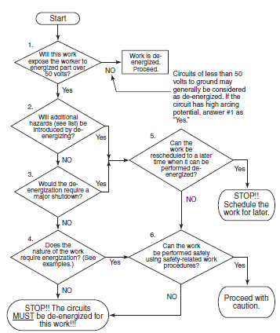
hot work decision tree

Slide 19
Will this work expose the worker to the energized part of over 50 volts?
Start
Work is De-energized proceed
NO
Circuits of less than 50
volts to ground may
generally be considered
as de-energized. If the
circuit has high arcing
potential, answer #1 as “YES”
YES
Will the additional Hazard be introduced by de-energizing?
Can the work be to a later time when it can be performed de-energized?
YES
NO
YES
Would the De-energization require a major shutdown?
STOP Schedule the work for later.
NO
NO
Does the nature of work require energization?
YES
Can the work be performed safely using safety-related work procedures?
YES
NO
Proceed with caution
STOP The circuits MUST be de-energized for this work.
NO

Slide 20
Examples of Additional Hazards
Interruption of life-support systems
Deactivation of emergency alarms
Shutdown of ventilation to hazardous locations
Removal of illumination from the work area

Slide 21
Examples of Collateral Costs That May Justify Energized Work
Excessive restart times in continuous process systems
High product loss costs (in polyethylene process, for example, the product has to be
physically dug out of process equipment after an unscheduled outage)
Testing electrical circuits (to verify de -energization, for example)
Troubleshooting complex controls
Infrared scan

Slide 22
Steps Required before De-energized Work May Commence
1. All energy control devices feeding the work area must be opened.
2. Locks and tags shall be placed on the energy control devices.
3. Voltage measurements shall be made at the point(s) of exposure to verify that the circuit is De-energized.
4. Safety grounds (if required) shall be placed to ensure the existence of an equipotential work zone.
5. The work area must be closely inspected by a qualified person to make certain that no energized parts remain. This critical step is often missed.

Slide 23
SAFE SWITCHING OF POWER SYSTEMS
De-energizing/clearing/Turning-off
Switching should be done by qualified personnel.
Non-load interrupting devices are not intended to interrupt any current flow.
Circuit breaks should never be closed after they interrupt a fault until the cause of the fault has been determined and corrected.

Slide 24
Remote Operation
There are at least three different ways that electrical switchgear such as circuit breakers and switches can be operated safely.
  Operating from a remote control room
  Operating using a remote operating device
  Operating manually from the device panel

Slide 25
Electrical Safety Analysis
Substation Electrical Load-1
Power from Generating station
Protective Fuse/C.B
Switch
Substation Electrical Load-2

Slide 26
Clearing procedures
The clearing procedures for even so simple a case, should include checking to ensure that no other sources exist and that the correct isolating device is being operated.
It is important that all persons who may be exposed to a hazard, as a result of a switching action, be notified prior to the action.
It is necessary to use written switching instructions for systems that may have several sources into an area.

Slide 27
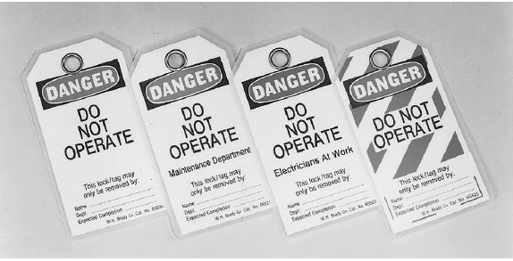

Slide 28
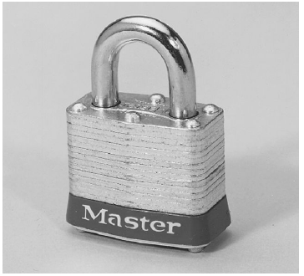
Typical padlocks suitable for lockout purposes.

Slide 29
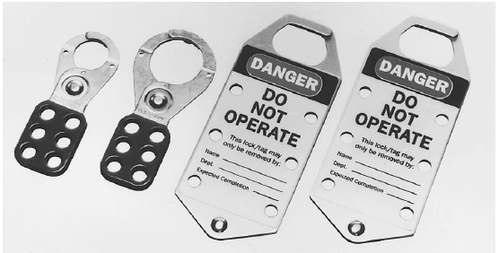
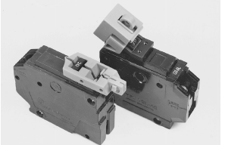
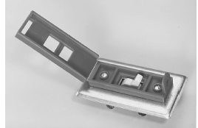
Multiple-lock devices.
Locking devices

Slide 30
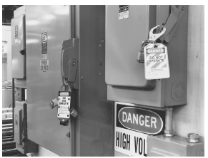
Typical application of locks, tags, and multiple-lock devices

Slide 31
Tag out & Lockout
Tags are used to identify equipment that has been removed from service for maintenance or other purposes. They are uniquely designed and have clear warnings printed on them instructing personnel not to operate the equipment.
Locks are applied to de-energized equipment to prevent accidental or unauthorized operation. Locks and tags are normally applied together.
Do Not Start, Do Not Open, Do Not Close, Do Not Operate

Slide 32
When to Use Locks and Tags
Locks and tags should be applied to open circuit breakers, switches, or contactors whenever personnel will be exposed to the conductors that are normally fed by those devices.
The application of the tags will warn and inform other employees that the equipment is not available for service, who applied the tag, and why the tag was applied.
The lock will prevent the operation of the breaker, switch, or contactor so that the circuit cannot be accidentally re-energized.
Minor inspections, adjustments, measurements, and other such servicing activities that are routine, repetitive, and integral to the use of the equipment do not require the placement of locks and tags.

Slide 33
Tags without Locks
Used under both of the following conditions:
The interrupting device (C.B) is not designed to accept a lock.
An extra means of isolation is employed to provide one additional level of protection.
Such an extra procedure might take the form of an additional open point such as removing a fuse or disconnecting a wire or the placement of safety grounds to provide an equipotential work area.

Slide 34
Locks without Tags
Used under both of the following conditions:
  The de-energization is limited to only one circuit or piece of equipment.
  The lockout lasts only as long as the employee who places the lock is on-site and in the immediate area.

Slide 35
Rules for Using Locks and Tags
All electric equipment with the capability to be reenergized and harm employees shall be safely isolated by means of a lock and tag during maintenance, repair, or modification of the equipment.

Slide 36
FLASH HAZARD CALCULATIONS AND
APPROACH DISTANCES
How close to an electrical hazard can I get?
Approach Distance Definitions
shock hazard distance and flash hazard distance
  The employee must be qualified to cross the boundary.
  The employee must be wearing appropriate personal protective equipment.
  Proper planning must be carried out to prepare the employee for the hazards he/she may face.

Slide 37
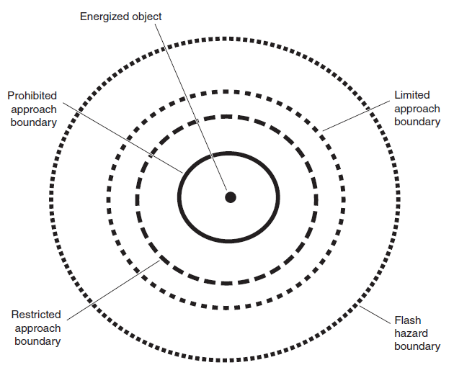
Minimum approach distance definition

Slide 38
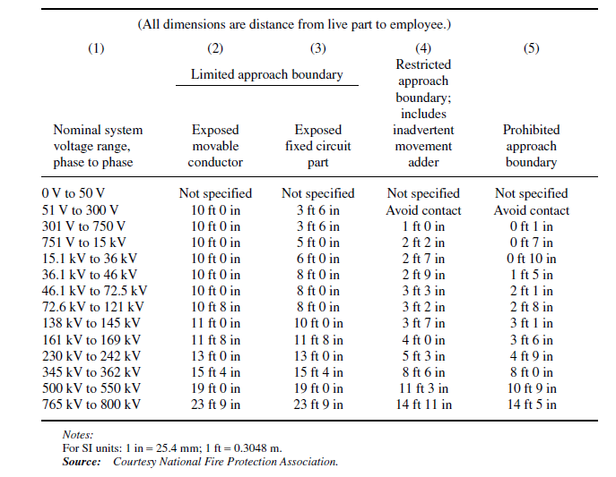
Approach Boundaries to Live Parts for Shock Protection

Slide 39
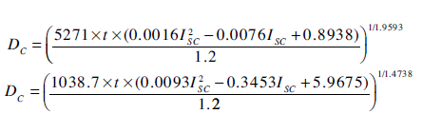
Low-Voltage Calculations (Below 600 V).

Slide 40
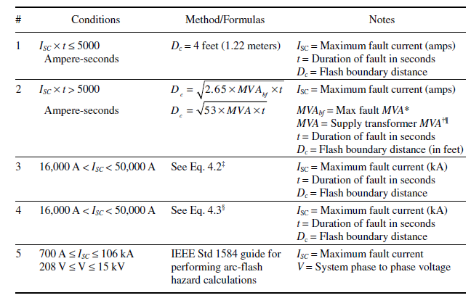
Calculating the Flash Hazard Minimum Approach Distance
(Flash Protection Boundary)

Slide 41
The Required Level of ARC Protection
Flash protection beyond normal cotton or wool work clothing is not required as long as all parts of the worker’s body stay outside the flash boundary as calculated above.
Outside the flash boundary, the minimum recommendation is either:
  Flame-resistant clothing with an ATPV of 4.5 cal/cm² or higher
  Natural fabric (cotton or wool) work clothing of 7 oz/yd² or more

Slide 42
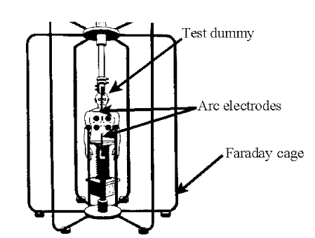
Electrical arc test setup used to determine
Arc Thermal Performance Value
Once Incident energies can be calculated, then protective clothing can be purchased with the necessary ratings.

Slide 43
Calculating Incident Energy Levels- Method-1
This method is based on a research by
Richard L. Doughty, Thomas E . Neal, and H. Landis Floyd.
Their research was bounded by the following conditions:
  Systems with voltage levels of 600 V and below
  Systems with maximum available short-circuit currents between 16 kA and 50 kA
  Working distances of equal to or greater than 18 in
After running numerous tests by creating electric arcs in open air, they took their results and performed a curve fit to predict the incident energy

Slide 44
Curve fit to predict the incident energy
E_{MA} = 5271D_{A}^{-1.9593}×t_{A}(0.0016I²_{SC} -0.0076I_{SC}+0.8938)
where E_{MA} = maximum open-air arc incident energy (cal/cm2)
DA = distance from the electrodes (in)—note that DA ≥ 18 in
t_{A} = duration of the arc (seconds)
I_{SC} = short-circuit current (kA)—note that ISC is the actual arc current, not the maximum bolted fault current
In the second part of their research, they created electrical arcs in a cubic box with one open side. The box was 20 in on a side and the measurements were taken at various distances from the open end.
E_{MA} = 1038.7D_{B}^{-1.4738}×t_{A}(0.0093I²_{SC} -0.3453I_{SC}+5.9675)
where E_{MB} = maximum arc-in-a-box incident energy (cal/cm2)
D_{B} = distance from the electrodes (in)—note that D_{B} ≥ 18 in

Slide 45
Estimation / curve fit
Y = [M]X
X = [M]⁻¹Y
^{Y-MX =error} when M rectangular
^{Min(error)2}

Slide 46
Arc-Flash Calculations
1. Arc flash current: The current of the arc, which is often less than the bolted fault current.
2. Incident energy: It is a measure of the thermal energy at a distance from an arc fault.
3. Flash boundary: A minimum distance from the energized object where the person cannot encroach.

Slide 47
Calculating Arc flash current (IEEE Standard 1584 -2002.)
One of the principal drawbacks of the Lee method is that the bolted fault current, which is used in that method, is always somewhat greater than the actual current flow when an electrical arc is formed.
log₁₀(I_{a}) = K + 0.662 log₁₀(I_{bf}) + 0.0966V + 0.000526G + 0.5588V log₁₀(I_{bf}) − 0.00304G log10(I_{bf}) (<1000 Volts)
log₁₀(I_{a}) = 0.00402 + 0.983 log₁₀(I_{bf})) (>1000 Volts)
Where Ia = arcing current (kA)
K = a constant (−0.153 for open configurations or −0.097 for box configurations)
Ibf = the bolted, RMS symmetrical, three-phase fault current (kA)
V = system phase-to-phase voltage (kV)
G = the gap between the arcing conductors (mm)

Slide 48
Calculating Incident Energy
The calculation of actual incident energy is done in two steps using the empirically derived arc current (I_{a}).
In step one, normalized incident energy (E_{n}) is calculated. E_{n} is normalized for an arcing time of 0.2 second and a distance from the arc of 610 mm.
log₁₀E_{n} = k₁ + k₂ + 1.081(log₁₀I_{a}) + 0.0011G
where En = normalized incident energy (cal/cm2)
k₁ = −0.792 for open-air arcs and −0.555 for arcs-in-a-box
k₂ = 0 for ungrounded and high-resistance ground systems and −0.113 for grounded systems
G = conductor gap (arc length) (mm)

Slide 49
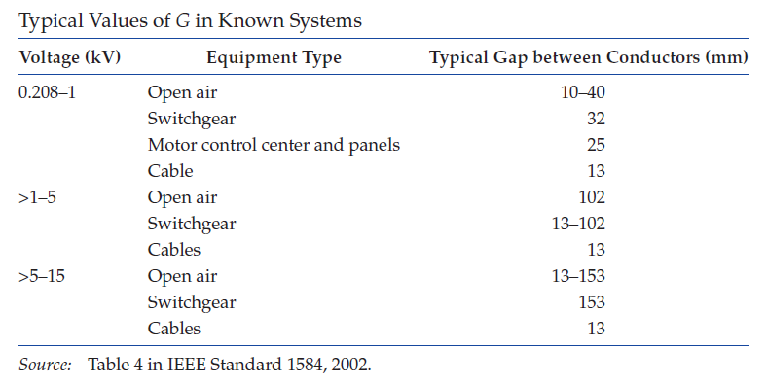

Slide 50
Flash-Hazard calculations - Problems
A 480 V motor control center (MCC) has a bolted fault current of 10 kA. Compute the arc current.
Consider 16 kV open air buses with bolted fault current of 10 kA, the gap between buses being 150 mm. Compute the arc flash current.
For a 480 V switch gear enclosure, compute the arc fault current if the bolted fault current is 5 kA.

Slide 51
where
E is the incident energy of the arc in cal/cm2
Cf is a calculation factor; it is 1.5 for system voltages at 1 kV or lower, and 1.0 for system voltages higher than 1 kV
t is the arcing time in seconds; it is the time it takes for the protection device to clear the fault
D is the distance between the arcing point and the person in mm; the typical value used is 460 mm (∼18 in.)
x is the distance factor; for known systems, x can be obtained from Table

Slide 52
For system voltages above 15 kV
The incident energy determines the amount of heat at the calculated distance.
Depending on its magnitude, the incident energy causes various degrees of burns to the human body.
The threshold for second-degree burns is 1.2 cal/cm². For values higher than this, third- and fourth-degree burns can occur.

Slide 53
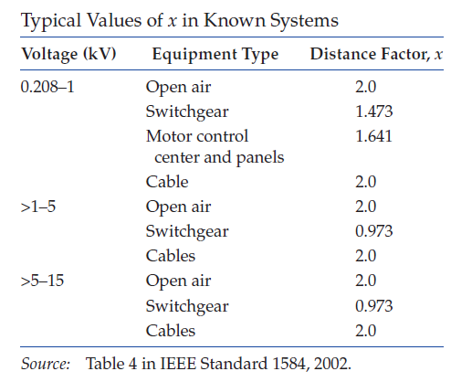

Slide 54
Incident Energy - Problems
For the system in Example-1, calculate the incident energy of the arc at 100 mm distance. Assume the clearing time is 4 ms.
For the case in Example-1, compute the incident energy at 18 in. (457.2 mm) away from the arcing point. Assume that the protection device clears the arc in 50 ms and the MCC system is ungrounded.
Hint: Find En and then E

Slide 55
Calculation of Arc Flash Protection Boundary
Below 15 kV
Above 15 kV

Slide 56
SAFETY PROCEDURES
Crossing the Limited Approach Boundary
Qualified workers may cross the limited approach boundary if they are qualified to perform the work.

Slide 57
Requirements for Crossing the Restricted Approach Boundary
The worker must be qualified to do the work.
There must be a plan in place that is documented and approved by the employer.
The worker must be certain that no part of the body crosses the prohibited approach boundary.
The worker must work to minimize the risk that may be caused by inadvertent movement by keeping as much of the body out of the restricted space as possible.
Allow only protected body parts to enter the restricted space as necessary to complete the work.
Personal protective equipment must be used appropriate for the hazards of the exposed energized conductor.

Slide 58
Requirements for Crossing the Prohibited Approach Boundary
The worker must have specified training required to work on energized conductors or circuit parts.
There must be a plan in place that is documented and approved by the employer.
A complete risk analysis must be performed.
Authorized management must review and approve the plan and the risk analysis.
Personal protective equipment must be used appropriate for the hazards of the exposed energized conductor.

Slide 59
Typical Situations That May Allow Reclosing of a Protective Device That Has Operated
The faulted section of the system is found and repaired.
The nature of the protective device makes it clear that no hazard is present. For example, if the device that operated is an overload type of device, it may be safe to reclose.
The reclosing operation can be made in such a way that the workers are not exposed to additional hazard.
For example, if the reclosing operation can be made by remote control, and if all personnel are kept away from all parts of the circuit, it may be reclosed.

Slide 60
The One-Minute Safety Audit
Notify responsible personnel of your presence in the area.
Listen for any abnormally loud or unusual noises. Sniff for unusual odors.
Locate all emergency exits. Locate all fire alarms and telephones.
Inspect all transformer liquid level, temperature, and pressure gauges to make certain that they are within acceptable limits.
Locate the station one-line diagram and make certain that it is legible and correct.
Make certain that the room is neat and tidy. Generally, electrical facilities should not be used for the storage of equipment.
Be certain that all required safety equipment is readily available and easily reached.
Check to see that all protective relay and other operational flags are properly reset.

Slide 61
Power Systems Safety Audit
An operating one-line diagram
Trained people operating and maintaining the power system.
De-energized work procedures
Energized work procedures.
Grounding
Corrosion
Maintenance practices
Switching procedures

Slide 62
Safety audit checklist
One-line diagram exists. Yes _____ No _____
One-line diagram is legible. Yes _____ No _____
One-line diagram is correct. Yes _____ No _____
All persons who operate the power system have easy access to the current one-line diagram.
Yes _____ No _____
Equipment is labeled correctly, legibly, and in accordance with the one-line diagram.
Yes _____ No _____
Persons who operate/maintain electrical equipment are trained for the voltage-class equipment they operate/maintain. Yes _____ No _____

Slide 63
Safety audit checklist
De-energized procedures and equipment exist and are used. Yes _____ No _____
Energized work procedures exist and are followed.
Yes _____ No _____
Equipment is grounded. Yes _____ No _____
Ground system is tested periodically. Yes _____ No _____
Electrical equipment is free from corrosion.
Yes _____ No _____
Proper maintenance practices are followed, especially for fault protection equipment. Yes _____ No _____

Slide 64
Safety audit checklist
Recent (less than five years old) relay/fuse coordination study exists, and relays are calibrated to the setting recommended. Yes _____ No _____
Power system is resistance grounded. Yes _____ No _____
Written switching orders are used. Yes _____ No _____

